Slide 1

Introduction to ICT
Welcome
Class: THP/Foundation 2021
Sukkur IBA University, Kandhkot Campus
Week - 01
Lecture - 02
Your Facilitator, Muzamil Hussain

Slide 2
Recap
What is ICT?
Where is ICT?
Difference between Data vs. Information
Components of Computer

Slide 3
Group Activity # 02
List down the followings.
Input Devices
Output Devices
Storage Devices
Communication Devices

Slide 4
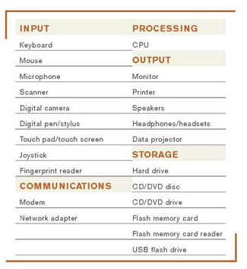
Group Activity # 02

Slide 5
Input Devices

Slide 6
What is Input?
Input is any data and instructions entered into the memory of a computer.
Instructions can be entered into the computer in the form of programs, commands, and user responses.
Program
A program is a series of related instructions that tells a computer what tasks to perform and how to perform them.
Command
Programs respond to commands that a user issues
User Response
A user response is an instruction a user issues by replying to a question displayed by a program

Slide 7
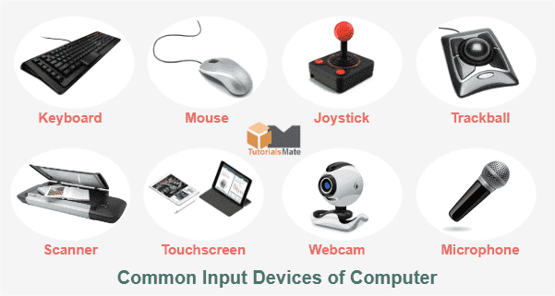
What is Input Device?
An input device is any hardware component that allows users to enter data and instructions into a computer

Slide 8
Keyboard
A keyboard is an input device that contains keys users press to enter data and instructions into a computer.
Most keyboards have:
Between 101 to 105 keys
A numeric keypad on the right side of the keyboard
Function keys, CTRL keys, ALT keys, and arrow keys
Windows key
Application key
Toggle keys

Slide 9
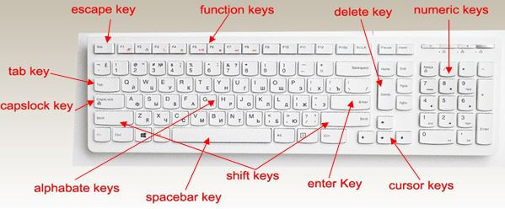
Keyboard

Slide 10
Pointing Devices
A pointing device is an input device that allows a user to control a pointer on the screen.
A pointer is a small symbol on the screen whose location and shape changes as a user moves a pointing device.

Slide 11
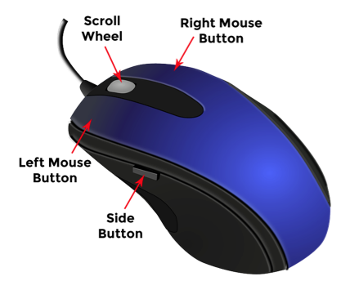
Mouse
A mouse is a pointing device that fits under the palm of your hand comfortably
Most widely used pointing device on desktop computers
A mouse can be wired or wireless

Slide 12
Mouse Operations
Click
Point
Right Click
Double Click
Rotate Wheel
Drag

Slide 13
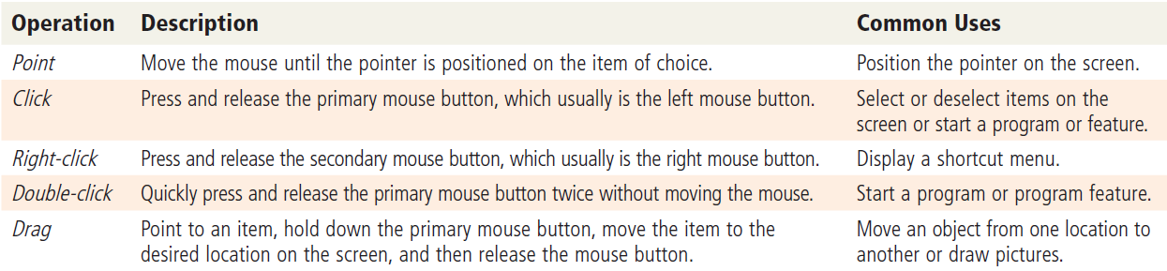
Mouse Operations

Slide 14
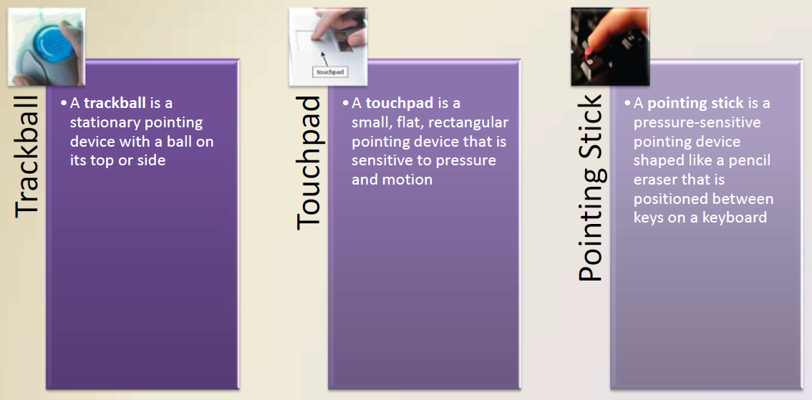
Other Pointing Devices

Slide 15
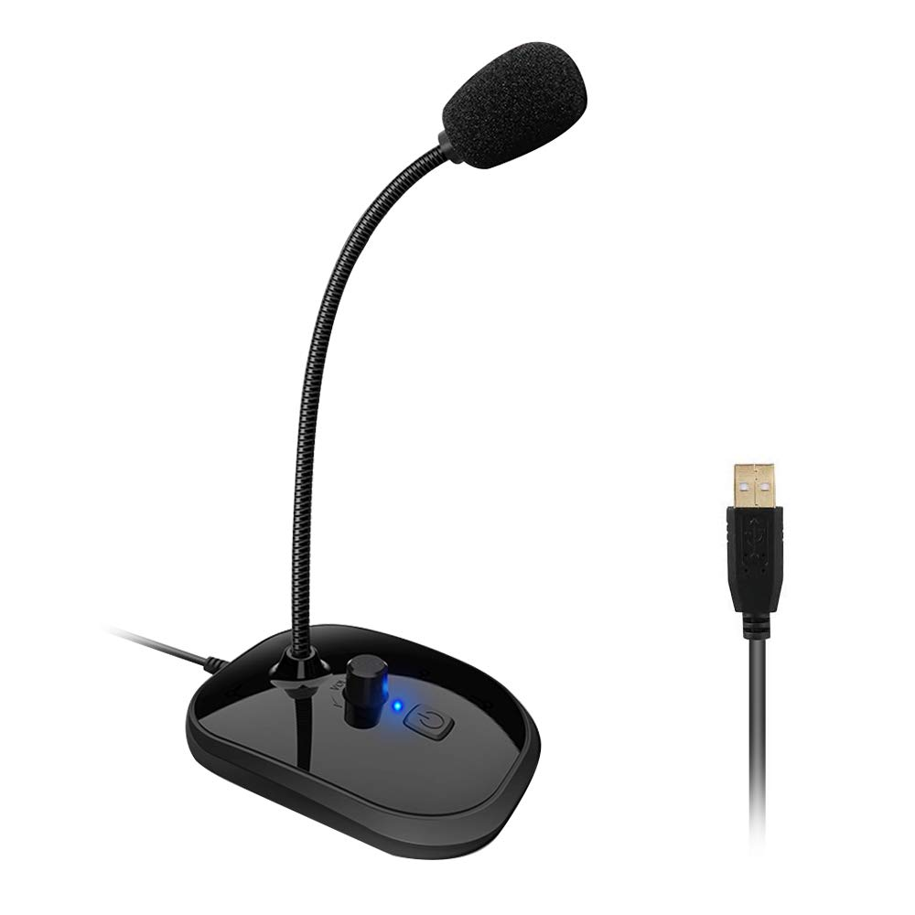
Voice Input
• Voice input is the process of entering input by speaking into a microphone.
A microphone is an input device that enables you to speak into a computer or mobile device.
• Voice recognition is the computer’s
capability of distinguishing spoken words.
Audio input is the process of entering any
Sound into the computer
Speech
Music
Sound Effects

Slide 16
Video Input
Video input is the process of capturing full-motion images and storing them on a computer’s storage medium.
A Web cam/digital camera is a type of digital video camera that enables a user to:
Capture video and
still images
Make video
telephone calls
Broadcast live
images over the
Internet
Add live images to instant messages

Slide 17
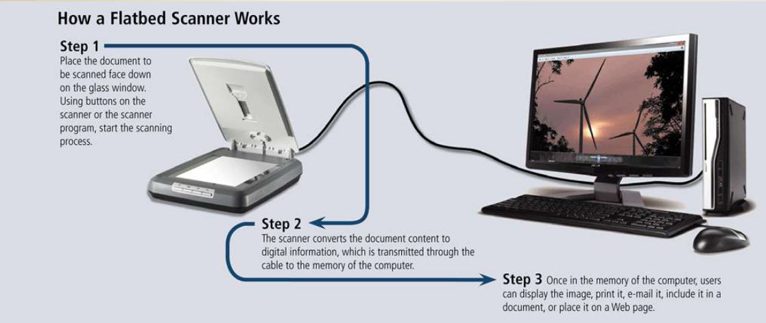
Scanners and Reading Devices

Slide 18
Scanners and Reading Devices
Optical character recognition (OCR) involves reading characters from ordinary documents.
Optical mark recognition (OMR) reads hand-drawn marks such as small circles or rectangles.
A bar code reader, also called a bar code scanner uses laser beams to read bar codes.
RFID (radio frequency identification) reader uses radio signals to communicate with a tag placed in or attached to an object.
Magnetic stripe card readers read the magnetic stripe on the back of cards.
MICR (magnetic ink character recognition) reader devices read text printed with magnetized ink and converts MICR characters into a form the computer can process.

Slide 19
Scanners and Reading Devices
Data collection devices obtain data directly at the location where the transaction or event takes place.
Used in:
– Restaurants
– Grocery stores
– Factories
– Warehouses

Slide 20
Output Devices

Slide 21
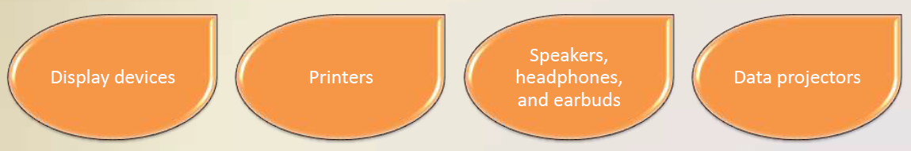
What is Output?
Output is data that has been processed into a useful form.
An output device is any type of hardware component that conveys information to one or more people.

Slide 22

Display Device
• A display device visually conveys text, graphics, and video information.
• A monitor is packaged as a separate peripheral
– LCD monitor
– Widescreen

Slide 23
Display Device
Liquid crystal display (LCD) uses a liquid compound to present information on a display device.
A CRT monitor is a desktop monitor that contains a cathode-ray tube.

Slide 24
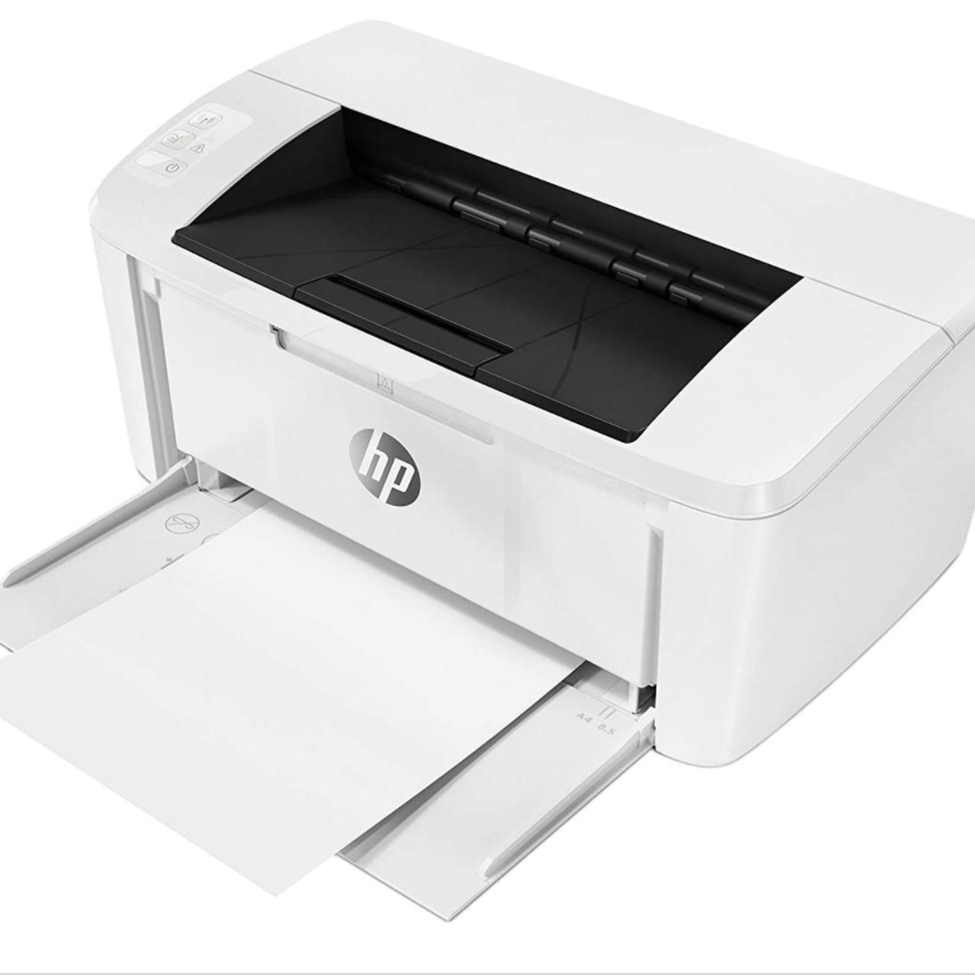
Printers
A printer produces text and graphics on a physical medium
– Printed information is called a hard copy, or printout
– Landscape or portrait orientation
Impact Printer
Line Printer
Dot Matrix Printer
Non Impact Printer
Ink Jet Printer
Laser Printer
Photo Printer
Plotter

Slide 25
Speakers, Headphones, and Earbuds
An audio output device produces music, speech, or other sounds.
Voice output occurs when you hear a person’s voice or when the computer talks to you through the speakers
Most computer users attach speakers to their computers to:
• Generate higher-quality sounds for playing games
• Interact with multimedia presentations
• Listen to music
• View movies

Slide 26
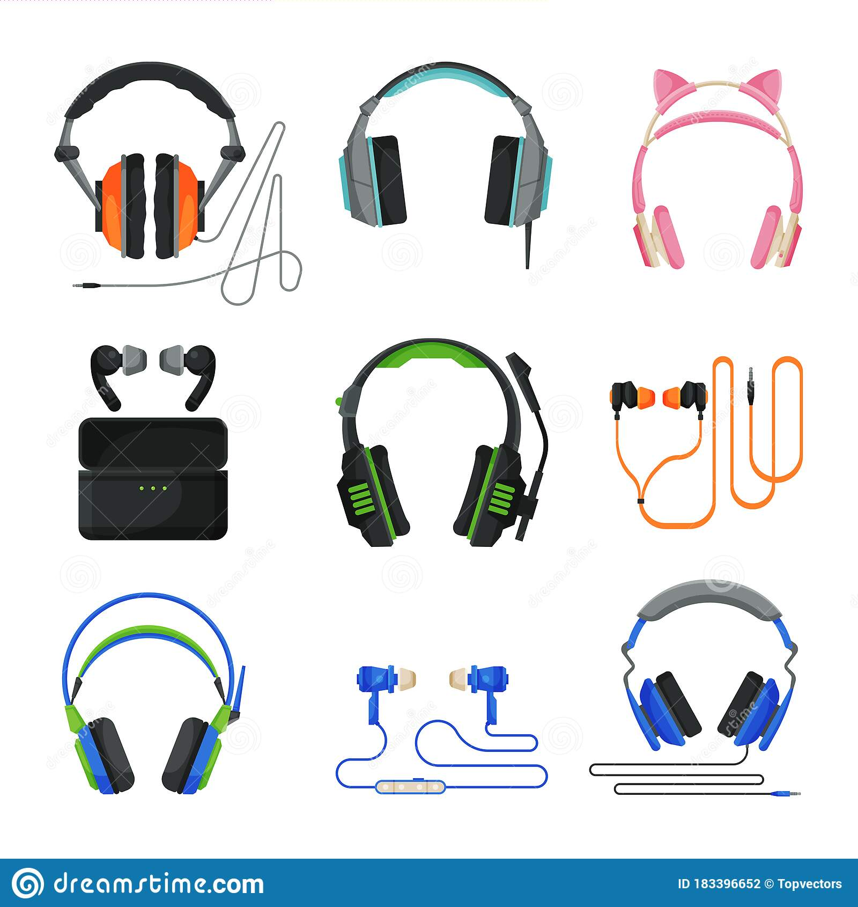
Speakers, Headphones, and Earbuds
Headphones are speakers that cover or are placed outside of the ear.
Earbuds (also called earphones) rest inside the ear canal.

Slide 27
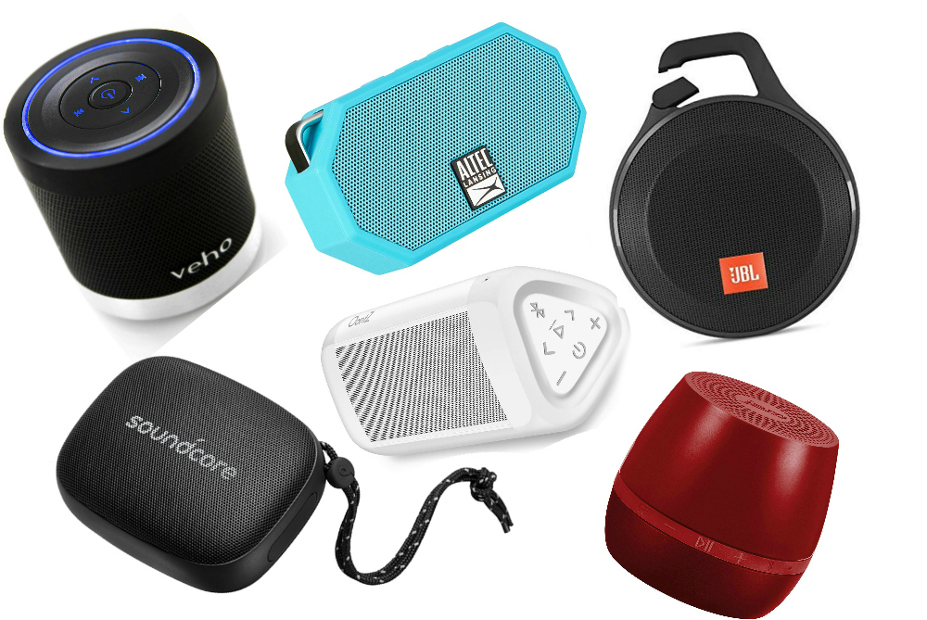
Speakers, Headphones, and Earbuds
Some speakers are specifically designed to play audio from a portable media player
– Wireless speakers

Slide 28
Memory and Storage

Slide 29
Memory and Storage
Memory
Storage
consists of electronic components that store instructions waiting to be executed and the data needed by those instructions.
Although some forms of memory are permanent, most memory keeps data and instructions temporarily, which means its contents are erased when the computer is shut off.
by contrast, holds data, instructions, and information for future use.
For example, computers can store hundreds or millions of student names and addresses permanently.

Slide 30
Storage Device and Storage Media
Storage holds data, instructions, and information for future use.
A storage media is the physical material on which a computer keeps data, instructions, and information.
A storage device is the computer hardware that records and/or retrieves items to and from storage media.
Reading is the process of transferring items from a storage medium into memory
Writing is the process of transferring items from memory to a storage medium

Slide 31
Hard Drive
A hard disk contains one or more inflexible, circular platters that use magnetic particles to store data, instructions, and information.
A hard disk is a storage device that contains one or more inflexible, circular platters that use magnetic particles to store data, instructions, and information.
Internal Hard disk
External/Removable Hard disk

Slide 32
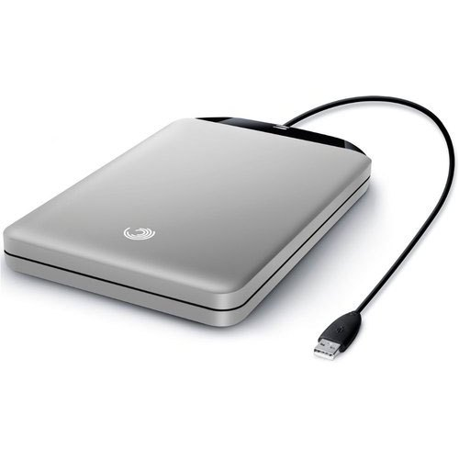
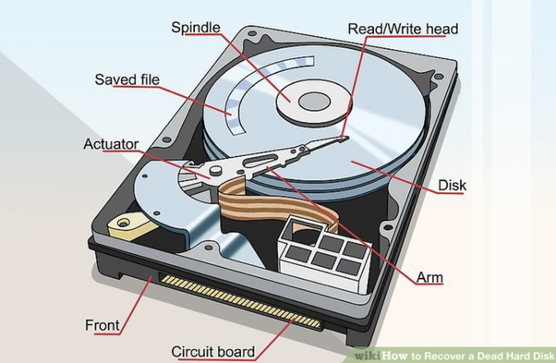
Hard Drive

Slide 33
Solid State Drive
A solid-state drive (SSD) is a storage device that typically uses flash memory to store data, instructions, and information.
Flash memory contains no moving parts, making it more durable and shock resistant than other types of media.
For this reason, some manufacturers are using SSDs instead of hard disks in their laptops, tablets, and desktops.
Advantages of SSD over hard disk:
Faster access time
Faster transfer rates
Last longer
Generate less heat and consume less power

Slide 34
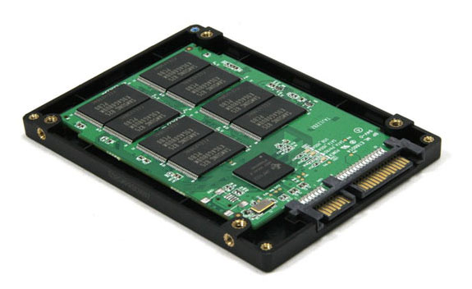
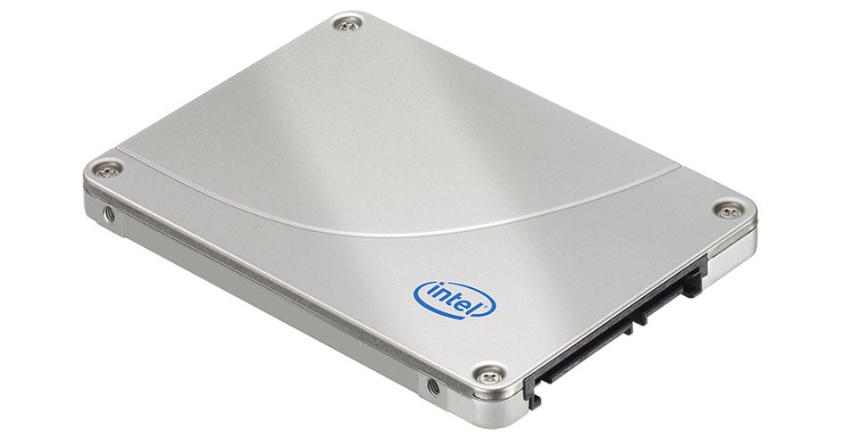
Solid State Drive

Slide 35
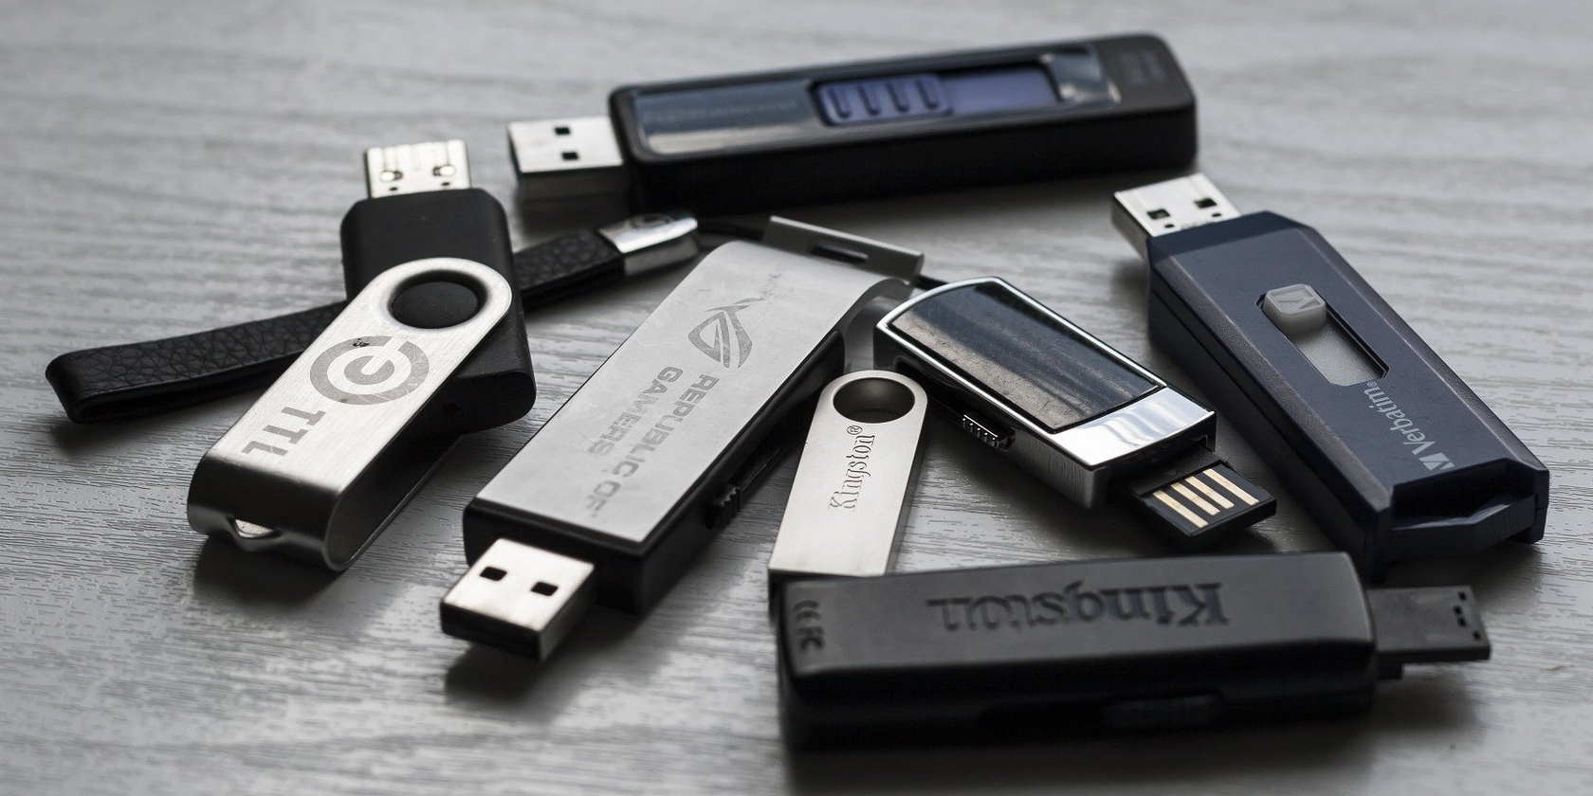
USB Flash Drive
A USB flash drive is a portable flash memory storage device that you plug in a USB port, which is a special, easily accessible opening on a computer or mobile device.
USB flash drives are convenient for mobile users because they are small and lightweight enough to be transported on a keychain or in a pocket.

Slide 36
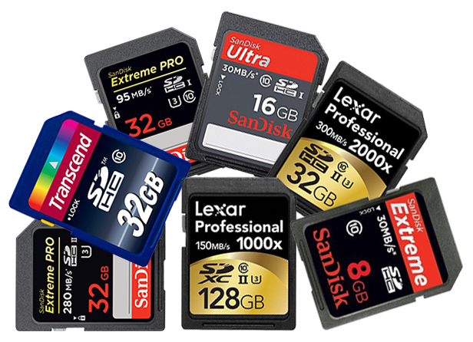
Memory Cards
A Memory card is removable flash memory, usually no bigger than 1.5 inches in height or width, that you insert in and remove from a slot in a computer, mobile device, or card reader/write.
With a card reader/writer, you can transfer the stored items, such as digital photos, from a memory card to a computer or printer that does not have a built-in card slot.

Slide 37
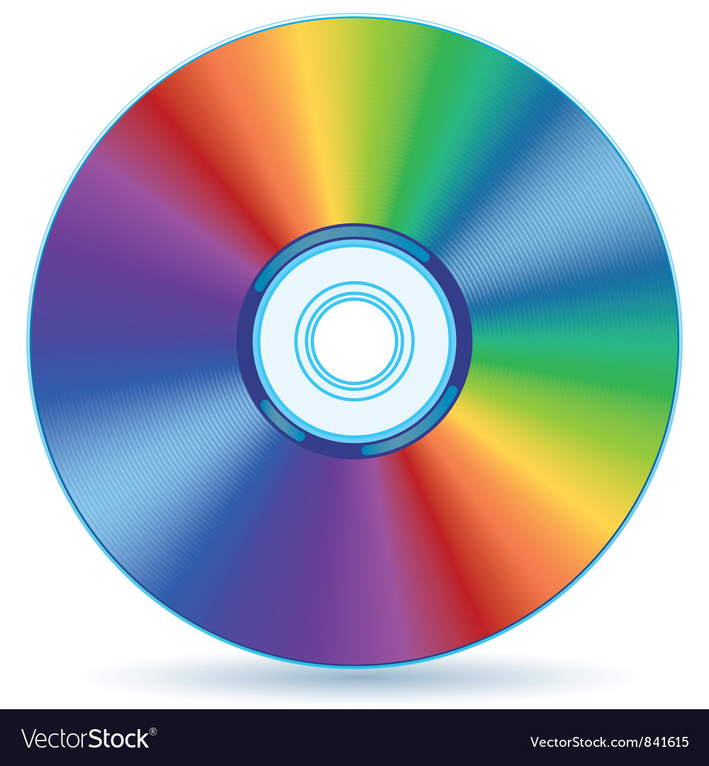
Optical Discs
• An optical disc consists of a flat, round, portable disc made of metal, plastic, and lacquer that is written and read by a laser
• Typically store software, data, digital photos, movies, and music
• Read only vs. rewritable

Slide 38
Cloud Storage
Instead of storing data, instructions, and information locally on a hard drive or other media, some users opt for cloud storage.
Cloud storage is an Internet service that provides remote storage to computer users.
For example, Figure 1-26 shows JustCloud, which provides cloud storage solutions to home and business users.

Slide 39
Communication Device

Slide 40
Communication
Communication: The process in which two or more computers or devices transfer data, instructions, and information is known as digital communications.
Today, even the smallest computers and devices can communicate directly with one another, with hundreds of computers on a corporate network, or with millions of other computers around the globe — often via the Internet.
Some communications involve cables and wires; others are sent wirelessly through the air.

Slide 41
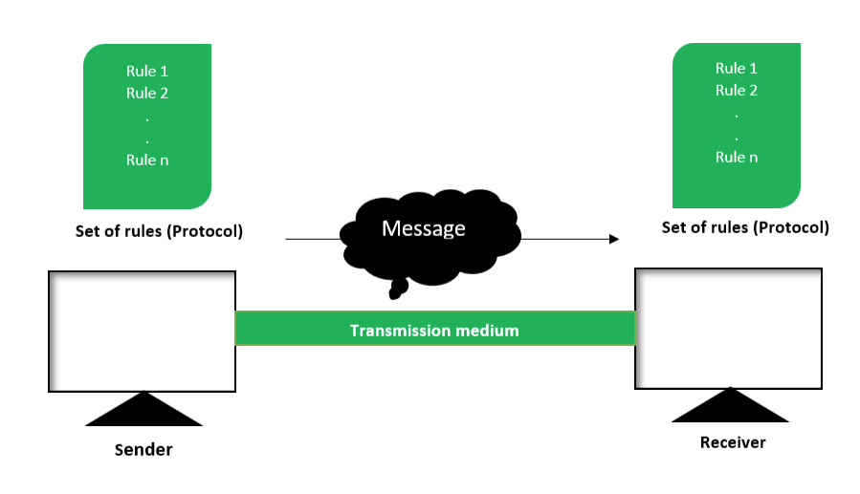
Components of Communication

Slide 42
Communication Device
A communication device is a hardware device capable of transmitting an analog or digital signal over the telephone, other communication wire, or wirelessly.
A classic example of a communication device is a computer modem, which converts a computer's digital information to an analog signal for transmission over a telephone line. Similarly, a modem receives analog signals, and converts them to digital, for processing by the computer.
Example:
Bluetooth devices
Infrared devices
Modem (over phone line)
Network card (using Ethernet)
Smartphone
Wi-Fi devices (using a Wi-Fi router)

Slide 43
Hardware
Input devices
Used to input data into the computer
Keyboards, mice, scanners, cameras, microphones, joysticks, touch pads, touch screens, fingerprint readers, etc.
Processing devices
Perform calculations and control computer’s operation
Central processing unit (CPU) and memory
Output devices
Present results to the user
Monitors, printers, speakers, projectors, etc.
Storage devices
Used to store data on or access data from storage media
Hard drives, CD/DVD discs and drives, USB flash drives, etc.
Communications devices
Allow users to communicate with others and to electronically access remote information
Modems, network adapters, etc.

Slide 44
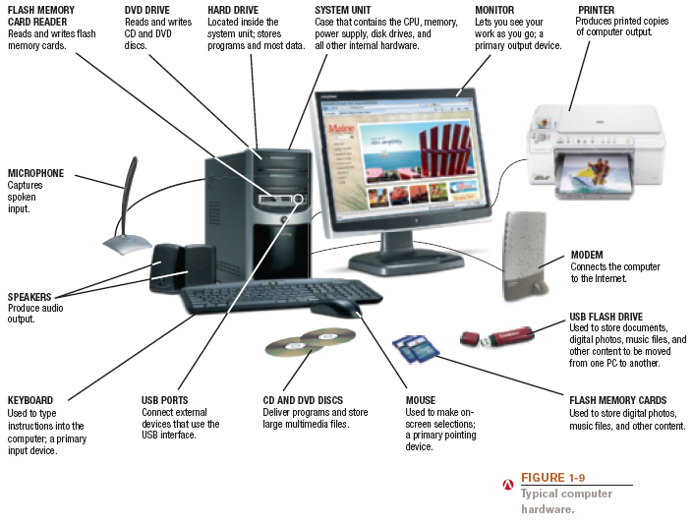
Hardware

Slide 45
Software
Software: The programs or instructions used to tell the computer hardware what to do
System software: Operating system starts up the computer and controls its operation
Without OS computer cannot function
Boots the computer and launches programs at the user’s direction
Most use a GUI to interact with the user via windows, icons, menus, buttons, etc.
Windows, Mac OS, Linux, etc.

Slide 46
Software
Application software: Performs specific tasks or applications
Creating letters, budgets, etc.
Managing inventory and customer databases
Editing photographs
Scheduling appointments
Viewing Web pages
Sending and receiving e-mail
Recording / playing CDs/DVDs
Designing homes
Playing games

Slide 47
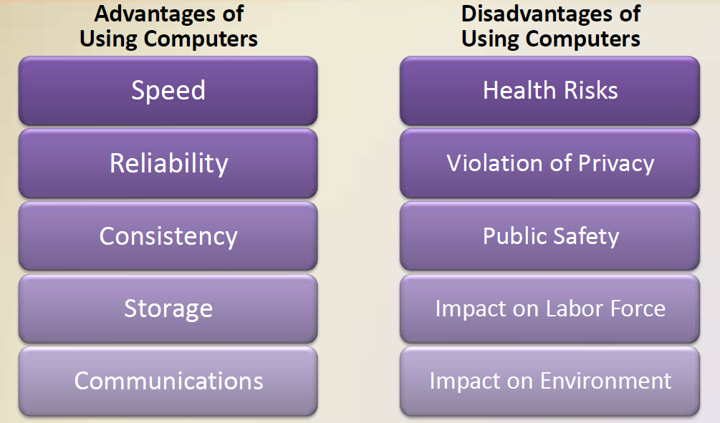
Advantages and Disadvantages of Using Computer

Slide 48
Thank you!
Any Questions???

